Slide 1

Sharp Security from All Angles
Secure From Scratch
Mastering Security in .NET Core 8 / Angular 17

Slide 2
After this workshop
Write code with less security vulnerabilities

Slide 3

Dr. Tiffany Ford
Software developer
Instructor
Security enthusiast

Slide 4
This is a Secure Programming Workshop
It’s a mindset
Can be applied to any programming language
Programming, nothing more.
Not SDLC, Secure By design, Threat modeling etc.

Slide 5
What is Secure Programming?
Programming that leads to less Security Bugs
Less security vulnerabilities.
Less Exploitation.
Less Harms.

Slide 6
The Goal of Secure From Scratch
Make Secure Programming the default
Form good habits

Slide 7
PREVENT - SFS Principles
Priority, Privacy, Permissions – Security is the #1 Priority
Reporting & logging
Easy to use securely
Verify
Errors & exceptions
Neat code
Trust Boundaries

Slide 8
Workshop Outline
Attacks against Angular17 and protections
XSS protection
Unpatched component – exploiting and mitigating vulnerable third party
CSRF and Cookies security features
anti-CSRF mechanism
Oh no, Secrets in the client

Slide 9
Workshop Outline
.NET CORE 8, Server-Side attacks and protections
How to exploit unrestricted File Upload
How to mitigate attacks when we allow user to upload files
SSRF - How to trick a service to perform request that we’re not allowed to.
SSRF – How to mitigate a situation where a service is exploited to perform request in the internal network
SQL – How to exploit an SQL vulnerability and how to code a secure data layer
Summary

Slide 10



Lab Domain: Recipes Web Application
Recipes
Add Recipes
Get Recipes
GetSecret
.NET 8.0 Web Api
SQL Server
Angular 17

Slide 11
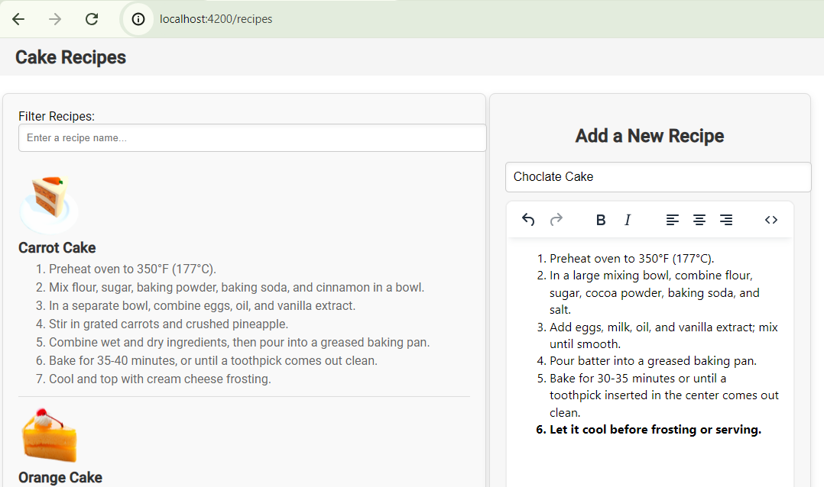
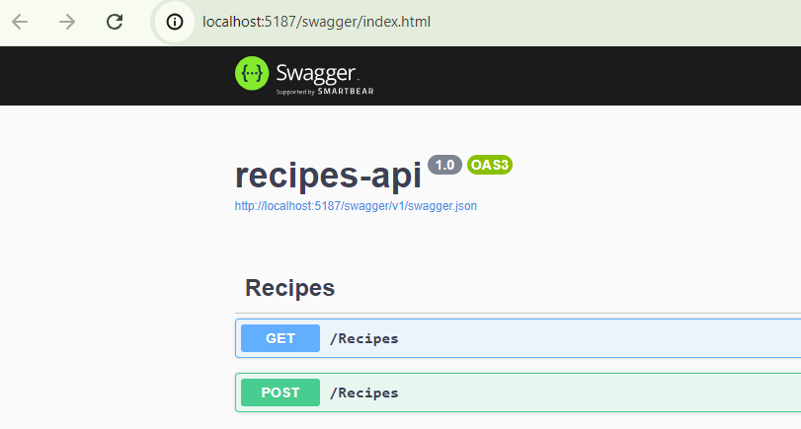
Run the Recipes Web Application

Slide 12
Part 1: Attacking and Defending Angular 17

Slide 13

Your Hacker’s Goal – Client-side Edition
Without looking at the code, just from the browser!
Can you spot a cookie?
Instead of plain HTML, add JavaScript code, that sends the cookie to another server.
Can you spot a secret in the code?

Slide 14

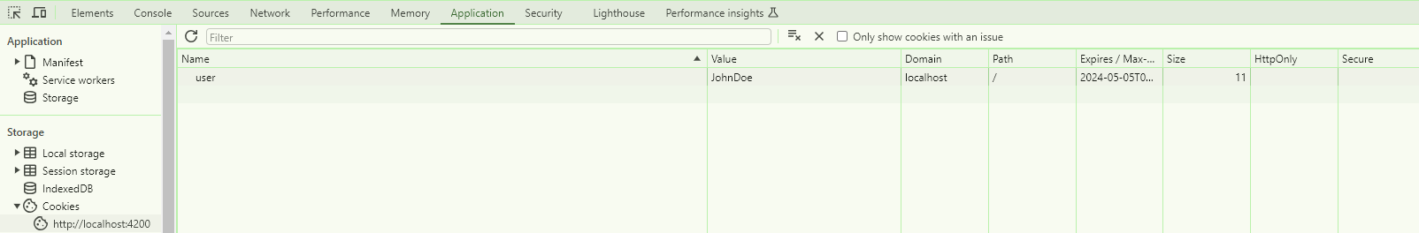
Your Hacker’s Goal – Spotting a Cookie
Can you spot a cookie?

Slide 15
Your Hacker’s Goal – Send somewhere (using JS)
Send the cookie to another server

Slide 16
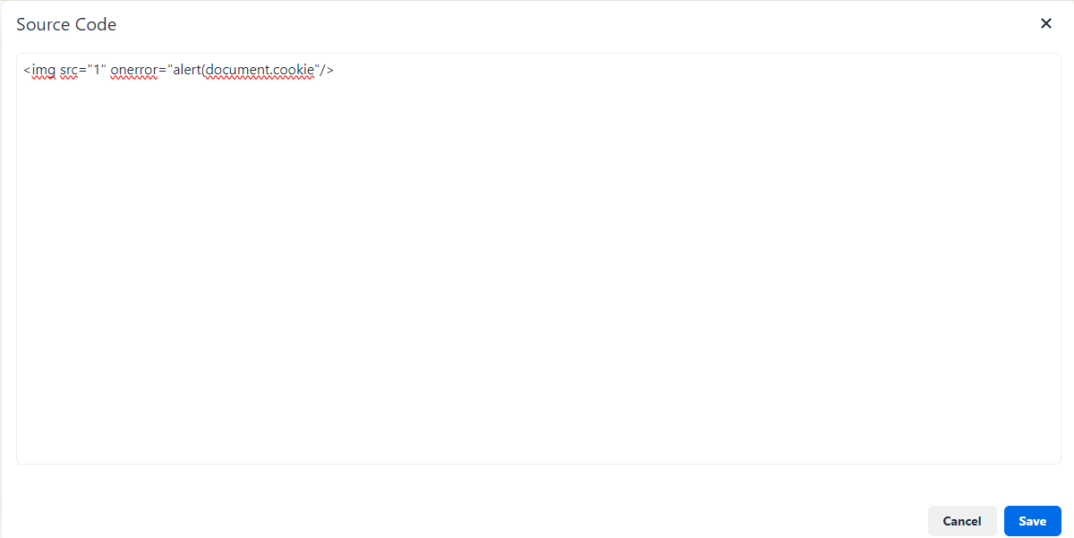
Your Hacker’s Goal – Send somewhere (using JS)
POC: First, Try to pop an alert
Use the WYSIWYG source code mode:

Slide 17
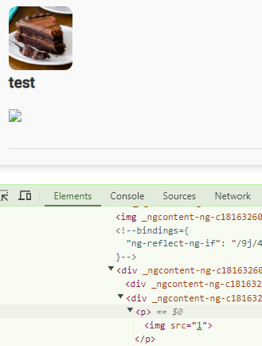
Your Hacker’s Goal – Send somewhere (using JS)
POC: First, Try to pop an alert
Use the WYSIWYG source code mode:

Slide 18
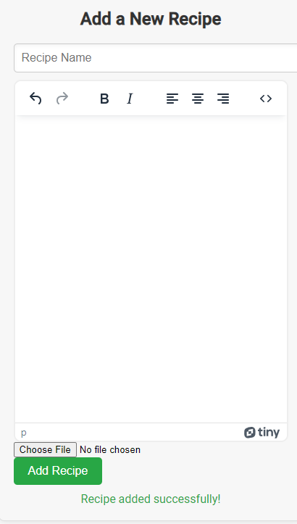
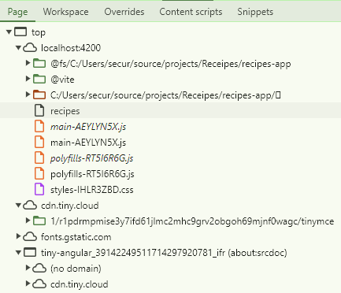
Your Hacker’s Goal – Send somewhere (using JS)
POC: Popping an alert
What WYSIWYG editor we’ve got?

Slide 19
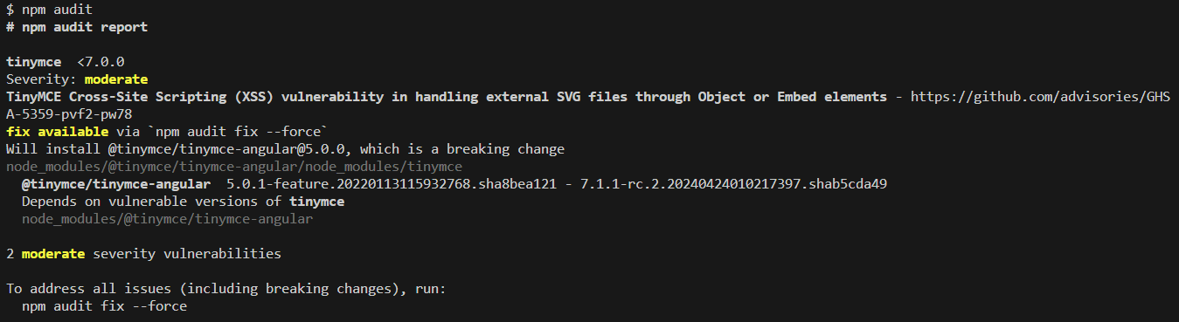
Your Hacker’s Goal – Send somewhere (using JS)
POC: Popping an alert
What WYSIWYG editor we’ve got?

Slide 20
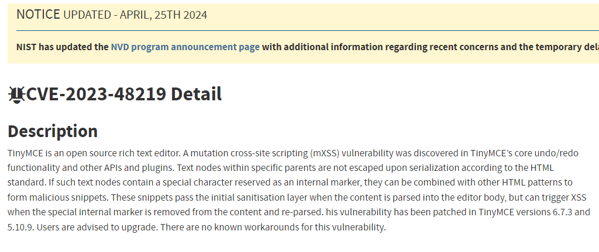
Your Hacker’s Goal – Send somewhere (using JS)
POC: Popping an alert
What WYSIWYG editor we’ve got?
Notes:
https://nvd.nist.gov/vuln/detail/CVE-2023-48219

Slide 21
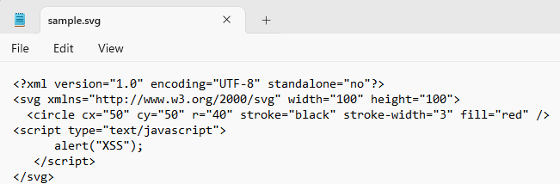
Your Hacker’s Goal – Send somewhere (using JS)
POC: Popping an alert
Add a recipe with a malicious svg file
Notes:
https://nvd.nist.gov/vuln/detail/CVE-2023-48219
Secure_Angular\recipes-api\Spoliers\Attacking_protecting\Files

Slide 22
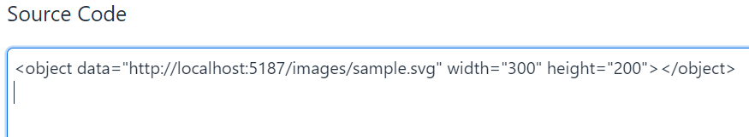
Your Hacker’s Goal – Send somewhere (using JS)
POC: Popping an alert
Add a recipe with the following code
Notes:
https://nvd.nist.gov/vuln/detail/CVE-2023-48219
<object data="http://localhost:5187/images/sample.svg" width="300" height="200"></object>

Slide 23
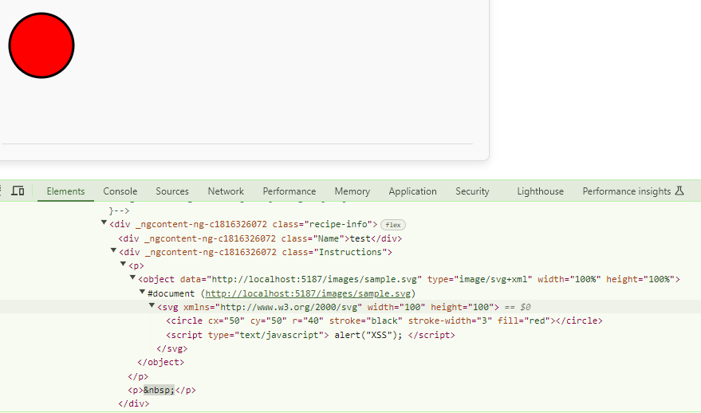
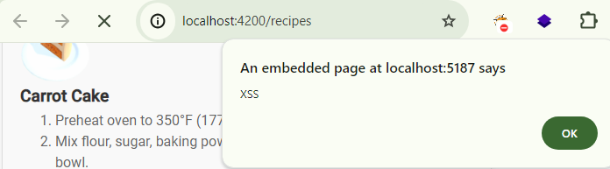
Your Hacker’s Goal – Send somewhere (using JS)
Notes:
https://nvd.nist.gov/vuln/detail/CVE-2023-48219

Slide 24
Your Hacker’s Goal – Send somewhere (using JS)
POC Successful
Weaponize it!
→ Send the cookie to another website
Notes:
https://nvd.nist.gov/vuln/detail/CVE-2023-48219

Slide 25
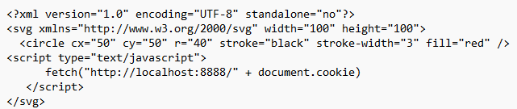
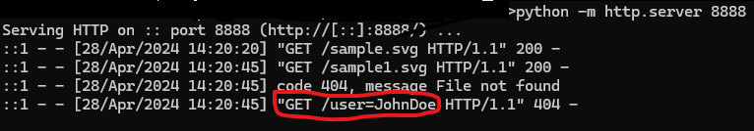
Your Hacker’s Goal – Send somewhere (using JS)
Send the cookie to another server (finally…)
Now, You Do It!
Notes:
https://nvd.nist.gov/vuln/detail/CVE-2023-48219

Slide 26
Defending Angular 17 - XSS

Slide 27

Vulnerability Found (XSS)
Let’s fix it!
Notes:
https://nvd.nist.gov/vuln/detail/CVE-2023-48219

Slide 28
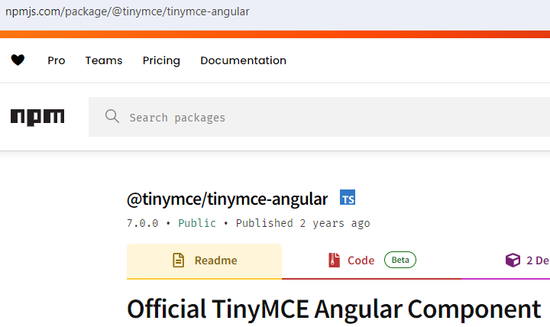
Let’s Fix It!
Can we?
Notes:
https://nvd.nist.gov/vuln/detail/CVE-2023-48219

Slide 29
PREVENT - SFS Principles
Priority, Privacy, Permissions
Reporting & logging
Easy to use securely
Verify
Errors & exceptions
Neat code
Trust Boundaries

Slide 30

Dealing with unpatched component
Notes:
https://nvd.nist.gov/vuln/detail/CVE-2023-48219

Slide 31
Dealing with unpatched component
Creating an angular-tinymce by ourselves
Blocking <object>s. What else do we want to block?
But we need to support Pdf, Video, SVG!
What now?
Notes:
https://nvd.nist.gov/vuln/detail/CVE-2023-48219

Slide 32
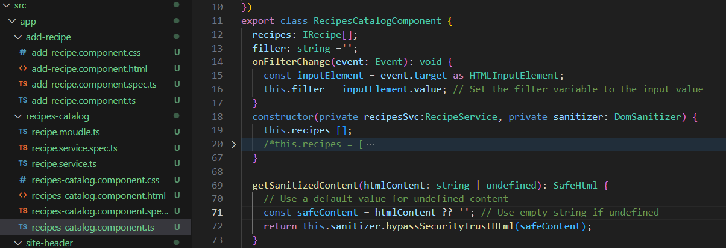
What’s wrong here?
Notes:
https://nvd.nist.gov/vuln/detail/CVE-2023-48219
sanitizer.bypassSecurityTrustHtml(untrustedHTML)
can create vulnerabilities if untrustedHTML comes directly from user input (because bypass methods tell Angular to trust that content, thereby possibly allowing malicious scripts to slip through).In other words, the snippet you’ve shown does not indicate an inherent security flaw. The potential for insecurity arises only if the sanitizer is misused (e.g., blindly trusting or bypassing security on user-supplied data).

Slide 33
PREVENT - SFS Principles
Priority, Privacy, Permissions
Reporting & logging
Easy to use securely
Verify
Errors & exceptions
Neat code
Trust Boundaries

Slide 34
Angular Anti-XSS Protection
Angular is easy to use securely!
If we don’t muck it up
Today it’s objects and mutation XSS, tomorrow another issue.
Don’t cancel the easy to use securely feature of Angular
Don’t use bypassSecurity methods!
Notes:
https://nvd.nist.gov/vuln/detail/CVE-2023-48219

Slide 35
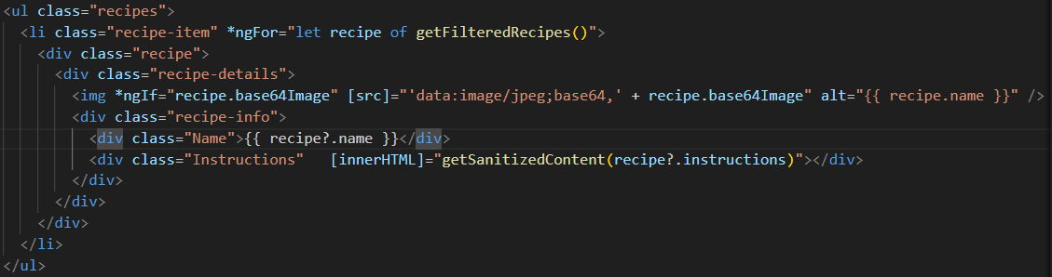
Angular Anti-XSS Protection
Notes:
https://nvd.nist.gov/vuln/detail/CVE-2023-48219

Slide 36
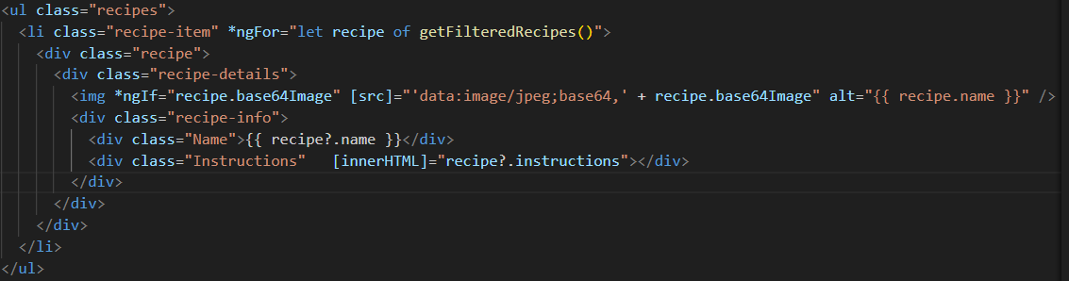
Angular Anti-XSS Protection
Notes:
https://nvd.nist.gov/vuln/detail/CVE-2023-48219

Slide 37
Angular Anti-XSS Protection
It’s Easy to Implement protection!
Cancel the bypass method
What else can we do?
Fix the cookie
Notes:
https://nvd.nist.gov/vuln/detail/CVE-2023-48219

Slide 38
Dealing with Cookies, what is wrong here?
Notes:
https://nvd.nist.gov/vuln/detail/CVE-2023-48219

Slide 39
PREVENT - SFS Principles
Priority, Privacy, Permissions
Reporting & logging
Easy to use securely
Verify
Errors & exceptions
Neat code
Trust Boundaries

Slide 40
Cookie Security Features
HttpOnly:
Does not allow the cookie to be accessed via JavaScript. This means that even if a malicious script runs on the client side, it cannot read from or tamper with that cookie.

Slide 41
Cookie Security Features
Secure: Ensures the cookie is sent only over secure channels, namely HTTPS. This attribute is used to enhance the security of the cookie by instructing browsers to only transmit the cookie when a connection is secure, thus protecting it from being exposed over non-secure HTTP connections where it could be intercepted by attackers.

Slide 42
Cookie Security Features
SameSite: Strict: Send the cookie only if the user is navigating within the website origin bounds
Lax: Cookies are not sent on normal cross-site subrequests ( i.e., Load images/frames into a third-party site), but are sent when a user is navigating away from the origin site (i.e., Following a link).

Slide 43
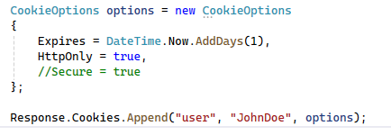
Dealing with Cookies, what is missing here?
Send the cookie from the server side (Controller for example)
Notes:
https://nvd.nist.gov/vuln/detail/CVE-2023-48219

Slide 44
Secure Cookies as Default
When do we want?
httponly secure samesite = strict
For which cookies?
All of them!

Slide 45
PREVENT - SFS Principles
Priority, Privacy, Permissions
Reporting & logging
Easy to use securely
Verify
Errors & exceptions
Neat code
Trust Boundaries

Slide 46
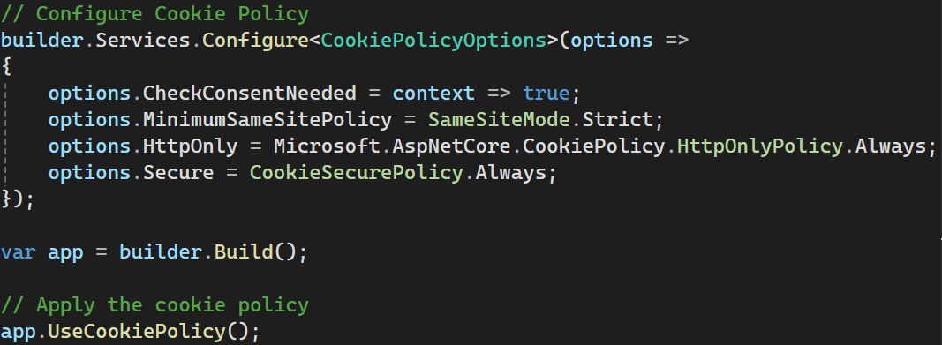
Secure Cookies as Default

Slide 47
Part 2: Attacking and Defending Angular 17 – Secrets Leak

Slide 48
Your Hacker’s Goal – Exposing Secrets
Can you spot a secret in the code?

Slide 49
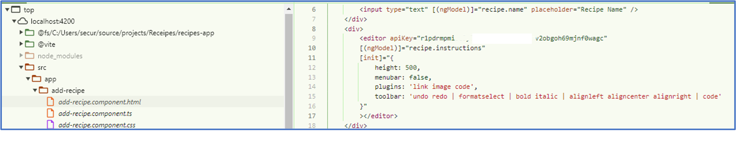
Your Hacker’s Goal – Exposing Secrets
Can you spot a secret in the code?

Slide 50
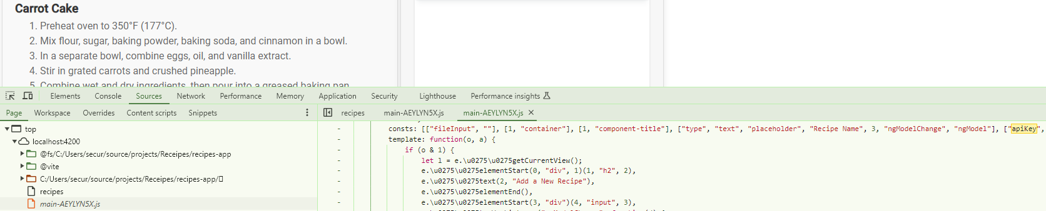
Your Hacker’s Goal – Exposing Secrets
Can you spot a secret in the code?
ng serve --configuration production

Slide 51
Dealing With ApiKey
Any Idea?
Notes:
https://nvd.nist.gov/vuln/detail/CVE-2023-48219

Slide 52
Dealing With ApiKey
I don’t care
Notes:
https://nvd.nist.gov/vuln/detail/CVE-2023-48219

Slide 53
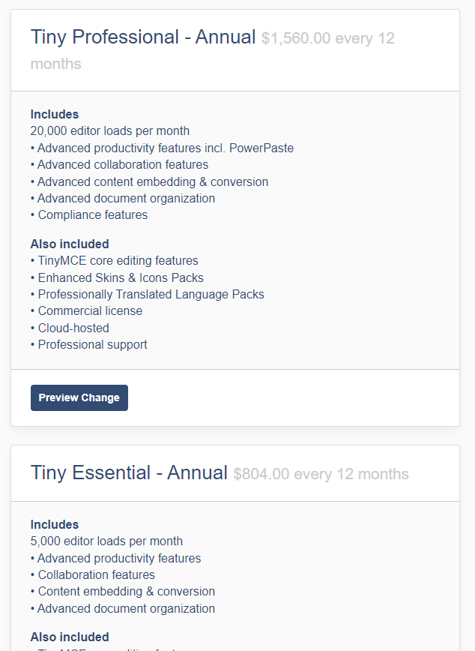
Dealing With ApiKey
Are you sure???
I don’t care
Notes:
https://nvd.nist.gov/vuln/detail/CVE-2023-48219

Slide 54
Dealing With ApiKey
Don’t use the CDN (content distribution network)
Notes:
https://nvd.nist.gov/vuln/detail/CVE-2023-48219

Slide 55
Dealing With ApiKey
Don’t use the CDN (content distribution network)
But the Angular component does it automatically!
Notes:
https://nvd.nist.gov/vuln/detail/CVE-2023-48219

Slide 56
Dealing With ApiKey
Use a different WYSIWYG
Notes:
https://nvd.nist.gov/vuln/detail/CVE-2023-48219

Slide 57
Dealing With ApiKey
Use a different WYSIWYG
But, maybe they have the same weakness?
Notes:
https://nvd.nist.gov/vuln/detail/CVE-2023-48219

Slide 58
Dealing With ApiKey
Ask the WYSIWYG developers to change
Could take a long time to happen
Notes:
https://nvd.nist.gov/vuln/detail/CVE-2023-48219

Slide 59
Who is a good candidate: Signed URL
Client asks for a signed URL from the server
Server sends an Api key to the CDN
The CDN returns a signed URL to the client
Our client uses the signed URL for getting the component.
The signed URL includes an expiration date.
Notes:
https://nvd.nist.gov/vuln/detail/CVE-2023-48219

Slide 60
Part 3: Attacking and Defending Angular 17 - CSRF

Slide 61
What is permission?
Allowing to do something
If we fail?
One user can perform actions on behalf of another one
One user can perform actions on behalf of an admin
CSRF – Cross site request forgery
When attacker tricks users to perform actions
Hacker’s actions, User’s permissions
Notes:
https://nvd.nist.gov/vuln/detail/CVE-2023-48219

Slide 62
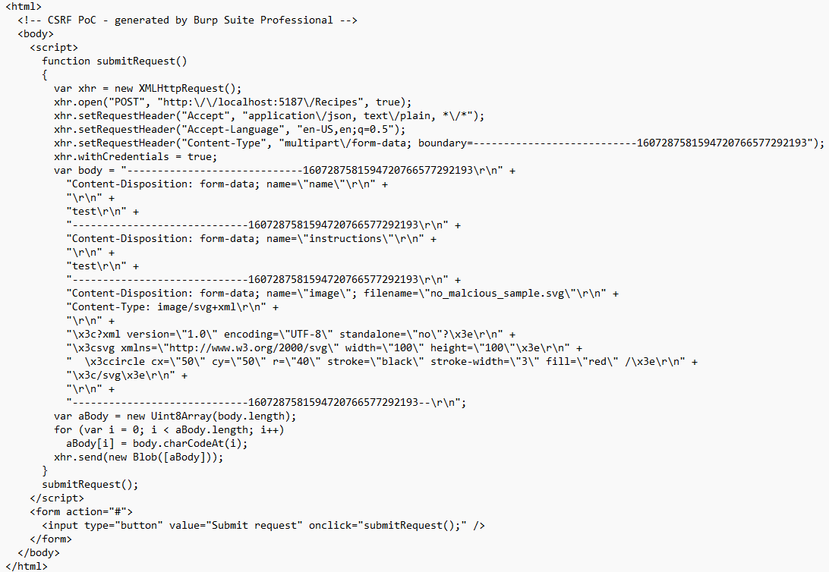
CSRF - PoC
Notes:
<html>
<!-- CSRF PoC - generated by Burp Suite Professional -->
<body>
<script>
function submitRequest()
{
var xhr = new XMLHttpRequest();
xhr.open("POST", "http:\/\/localhost:5187\/Recipes", true);
xhr.setRequestHeader("Accept", "application\/json, text\/plain, *\/*");
xhr.setRequestHeader("Accept-Language", "en-US,en;q=0.5");
xhr.setRequestHeader("Content-Type", "multipart\/form-data; boundary=---------------------------1607287581594720766577292193");
xhr.withCredentials = true;
var body = "-----------------------------1607287581594720766577292193\r\n" +
"Content-Disposition: form-data; name=\"name\"\r\n" +
"\r\n" +
"test\r\n" +
"-----------------------------1607287581594720766577292193\r\n" +
"Content-Disposition: form-data; name=\"instructions\"\r\n" +
"\r\n" +
"test\r\n" +
"-----------------------------1607287581594720766577292193\r\n" +
"Content-Disposition: form-data; name=\"image\"; filename=\"no_malcious_sample.svg\"\r\n" +
"Content-Type: image/svg+xml\r\n" +
"\r\n" +
"\x3c?xml version=\"1.0\" encoding=\"UTF-8\" standalone=\"no\"?\x3e\r\n" +
"\x3csvg xmlns=\"http://www.w3.org/2000/svg\" width=\"100\" height=\"100\"\x3e\r\n" +
" \x3ccircle cx=\"50\" cy=\"50\" r=\"40\" stroke=\"black\" stroke-width=\"3\" fill=\"red\" /\x3e\r\n" +
"\x3c/svg\x3e\r\n" +
"\r\n" +
"-----------------------------1607287581594720766577292193--\r\n";
var aBody = new Uint8Array(body.length);
for (var i = 0; i < aBody.length; i++)
aBody[i] = body.charCodeAt(i);
xhr.send(new Blob([aBody]));
}
submitRequest();
</script>
<form action="#">
<input type="button" value="Submit request" onclick="submitRequest();" />
</form>
</body>
</html>

Slide 63
Protect permissions (against CSRF)
How can we protect from CSRF?
Notes:
https://nvd.nist.gov/vuln/detail/CVE-2023-48219

Slide 64
Cookie Security Features – partial CSRF protection
How does SameSite(Strict/Lax) prevent CSRF?

Slide 65
Cookie Security Features - Reminder
SameSite: Strict: Send the cookie only if the user is navigating within the website origin bounds
Lax: Cookies are not sent on normal cross-site subrequests ( i.e., Load images/frames into a third-party site), but are sent when a user is navigating away from the origin site (i.e., Following a link).

Slide 66
Cookie Security Features – partial CSRF protection
How CSRF Works A CSRF attack exploits the trust that a site has in a user's browser. Essentially, it tricks the user's browser into sending a request to a web application where the user is already authenticated, using cookies that are automatically included with requests to that domain. This can result in unwanted actions being performed on the user's behalf without their consent.

Slide 67
Cookie Security Features – partial CSRF protection
How Does SameSite prevent CSRF? Cookies are sent with same-site requests and with cross-site top-level navigations that use safe methods (like GET).
This setting prevents cookies from being sent on requests initiated by third-party websites in sub-resources or in iframes, or via POST requests, which are commonly used in CSRF attacks.

Slide 68
Protect permissions (against CSRF)
Find how to protect from CSRF
Is SameSite option enough?
What else?
Notes:
https://nvd.nist.gov/vuln/detail/CVE-2023-48219

Slide 69
Protect permissions (against CSRF)
Where do we put the solution?
Angular?
.NET?
Notes:
https://nvd.nist.gov/vuln/detail/CVE-2023-48219

Slide 70
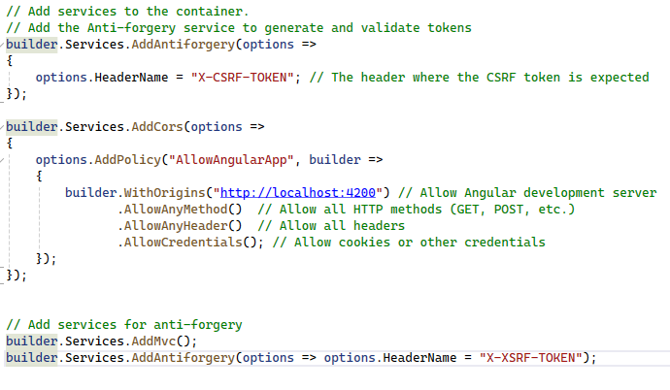
Protect permissions (against CSRF)
.NET 8.0 Web Api, program.cs
Notes:
https://angular.io/guide/http-security-xsrf-protection
https://learn.microsoft.com/en-us/aspnet/core/security/anti-request-forgery?view=aspnetcore-8.0
builder.Services.AddAntiforgery(options =>
{
// Set Cookie properties using CookieBuilder properties†.
options.FormFieldName = "AntiforgeryFieldname";
options.HeaderName = "X-CSRF-TOKEN-HEADERNAME";
options.SuppressXFrameOptionsHeader = false;
});

Slide 71
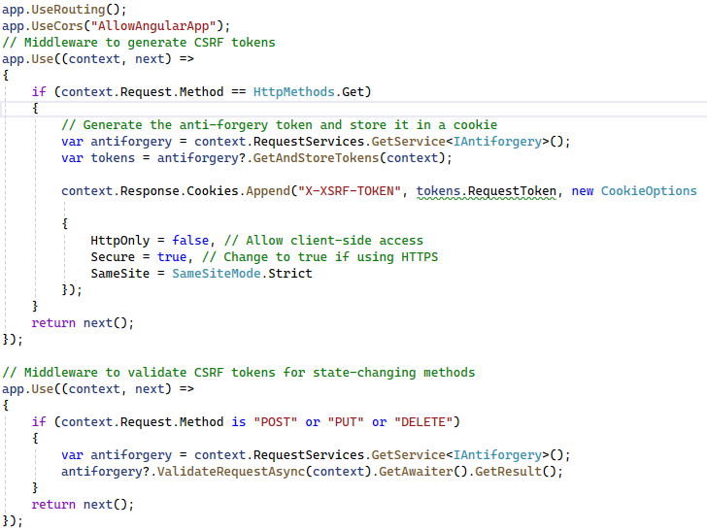
Protect permissions (against CSRF)
.NET 8.0 Web Api, program.cs
Notes:
https://angular.io/guide/http-security-xsrf-protection
https://learn.microsoft.com/en-us/aspnet/core/security/anti-request-forgery?view=aspnetcore-8.0
builder.Services.AddAntiforgery(options =>
{
// Set Cookie properties using CookieBuilder properties†.
options.FormFieldName = "AntiforgeryFieldname";
options.HeaderName = "X-CSRF-TOKEN-HEADERNAME";
options.SuppressXFrameOptionsHeader = false;
});

Slide 72
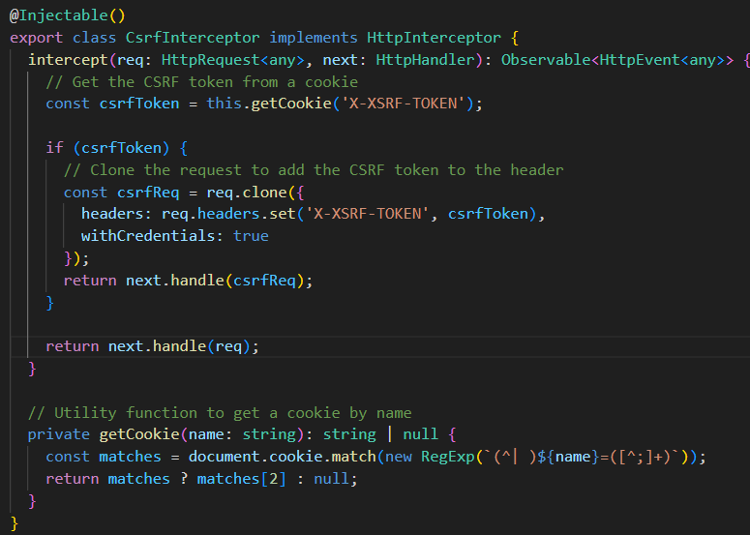
Protect permissions (against CSRF)
Angular 17
Creating Interceptor
Notes:
https://angular.io/guide/http-security-xsrf-protection
https://learn.microsoft.com/en-us/aspnet/core/security/anti-request-forgery?view=aspnetcore-8.0
builder.Services.AddAntiforgery(options =>
{
// Set Cookie properties using CookieBuilder properties†.
options.FormFieldName = "AntiforgeryFieldname";
options.HeaderName = "X-CSRF-TOKEN-HEADERNAME";
options.SuppressXFrameOptionsHeader = false;
});

Slide 73
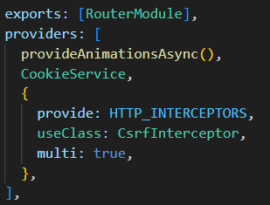
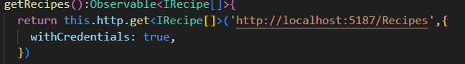
Protect permissions (against CSRF)
Angular 17
Register the interceptor in the app module
Invoking get with withCredentials
Notes:
https://angular.io/guide/http-security-xsrf-protection
https://learn.microsoft.com/en-us/aspnet/core/security/anti-request-forgery?view=aspnetcore-8.0
builder.Services.AddAntiforgery(options =>
{
// Set Cookie properties using CookieBuilder properties†.
options.FormFieldName = "AntiforgeryFieldname";
options.HeaderName = "X-CSRF-TOKEN-HEADERNAME";
options.SuppressXFrameOptionsHeader = false;
});

Slide 74
CSRF - PoC
Check Again ☺
Notes:
<html>
<!-- CSRF PoC - generated by Burp Suite Professional -->
<body>
<script>
function submitRequest()
{
var xhr = new XMLHttpRequest();
xhr.open("POST", "http:\/\/localhost:5187\/Recipes", true);
xhr.setRequestHeader("Accept", "application\/json, text\/plain, *\/*");
xhr.setRequestHeader("Accept-Language", "en-US,en;q=0.5");
xhr.setRequestHeader("Content-Type", "multipart\/form-data; boundary=---------------------------1607287581594720766577292193");
xhr.withCredentials = true;
var body = "-----------------------------1607287581594720766577292193\r\n" +
"Content-Disposition: form-data; name=\"name\"\r\n" +
"\r\n" +
"test\r\n" +
"-----------------------------1607287581594720766577292193\r\n" +
"Content-Disposition: form-data; name=\"instructions\"\r\n" +
"\r\n" +
"test\r\n" +
"-----------------------------1607287581594720766577292193\r\n" +
"Content-Disposition: form-data; name=\"image\"; filename=\"no_malcious_sample.svg\"\r\n" +
"Content-Type: image/svg+xml\r\n" +
"\r\n" +
"\x3c?xml version=\"1.0\" encoding=\"UTF-8\" standalone=\"no\"?\x3e\r\n" +
"\x3csvg xmlns=\"http://www.w3.org/2000/svg\" width=\"100\" height=\"100\"\x3e\r\n" +
" \x3ccircle cx=\"50\" cy=\"50\" r=\"40\" stroke=\"black\" stroke-width=\"3\" fill=\"red\" /\x3e\r\n" +
"\x3c/svg\x3e\r\n" +
"\r\n" +
"-----------------------------1607287581594720766577292193--\r\n";
var aBody = new Uint8Array(body.length);
for (var i = 0; i < aBody.length; i++)
aBody[i] = body.charCodeAt(i);
xhr.send(new Blob([aBody]));
}
submitRequest();
</script>
<form action="#">
<input type="button" value="Submit request" onclick="submitRequest();" />
</form>
</body>
</html>

Slide 75
Part 4: Attacking and Defending .net core 8 web api – File Upload

Slide 76
Your Hacker’s Goal – Server-Side Edition
Hackers LOVE to upload!
Try to upload a file.
What files can you upload?
What can you do with those files?

Slide 77
PREVENT - SFS Principles
Priority, Privacy, Permissions
Reporting & logging
Easy to use securely
Verify
Errors & exceptions
Neat code
Trust Boundaries

Slide 78
Your Hacker’s Goal – Server-Side Edition
The risks of unrestricted file upload
Malware Upload
Web Shells, executables
Overwriting Important Files
Denial of Service (DoS)
Storage of Illegal Content
Cross-site Scripting (XSS)
Bypassing File Type Restrictions**

Slide 79
Your Hacker’s Goal – Server-Side Edition
The risks of unrestricted file upload
Malware Upload
Web Shells, executables
Overwriting Important Files
Overwriting other users Files
Denial of Service (DoS)
Storage of Illegal Content
Cross-site Scripting (XSS)
What is going to happen if you’ll overwrite the appsettings.json?

Slide 80
Your Hacker’s Goal – Server-Side Edition
Exploit!
Upload an exe file
Override the appsettings.json
NOTE: For simplicity, disable CSRF/Anti-forgery
You can use:
burp, C# console application, python script , PowerShell

Slide 81
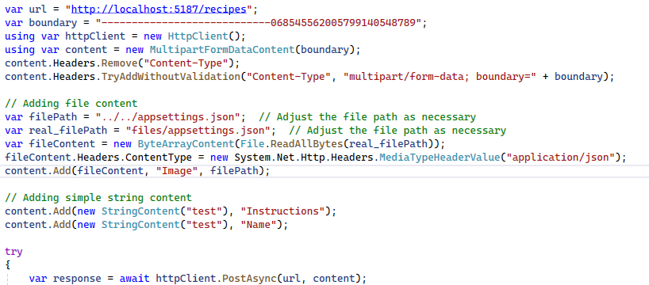
Your Hacker’s Goal – Server-Side Edition
Override the appsettings
Developers are the best hackers ☺
You don’t need tools, you have csharp!

Slide 82
Restrict File Upload!
What should you take care of?

Slide 83
Restrict File Upload!
What should you take care of?
Block problematic extensions
Allow specific extensions
Allow specific mimetypes
Make sure the upload takes place in a dedicated folder
Give the uploaded file a unique name
Pay Attention to error messages you return to the client

Slide 84
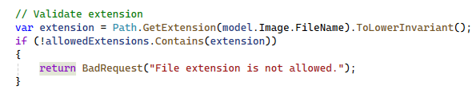
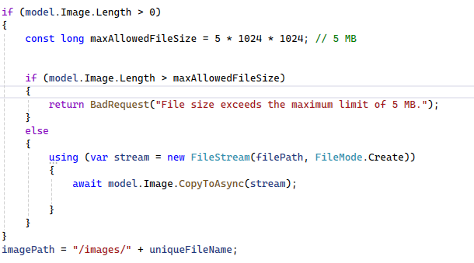
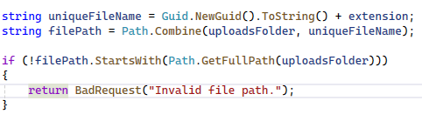
Restrict File Upload!
What is missing here?

Slide 85
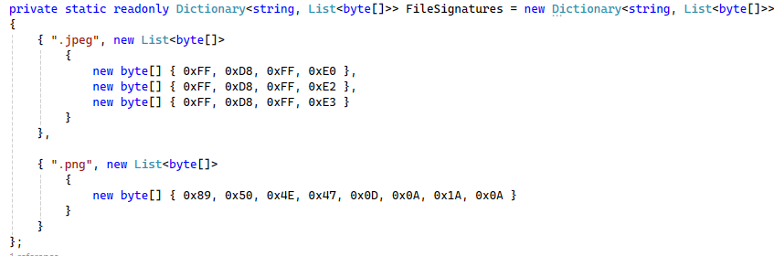
Restrict File Upload!
Check the magic bytes to find the mimetype

Slide 86
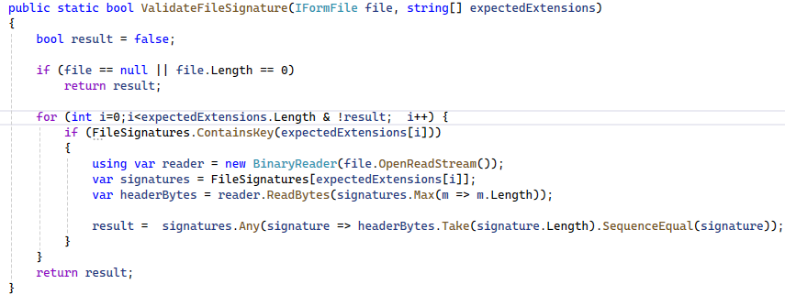
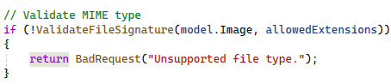
Restrict File Upload!
Check the magic bytes to find the mimetype

Slide 87
Your Hacker’s Goal – Server-Side Edition
Check yourself after the fix!
Upload an exe file
Exploit the upload functionality to overrun the appsettings.json
You can use burp, console application in C#, python, PowerShell

Slide 88
Your Hacker’s Goal – Server-Side Edition
Detect an alternative method to upload recipes
How can you exploit the functionality?
Try to get files that you’re not allowed to
Try to exploit the vulnerability to get information

Slide 89
Your Hacker’s Goal – Server-Side Edition
Detect an alternative method to upload recipes
How can you exploit the functionality?
Try to get files that you’re not allowed to
Try to exploit the vulnerability to get information
What if the URL is in our own server? Will we be able to access images of other users?
What if instead of an image we’ll take something else?

Slide 90
PREVENT - SFS Principles
Priority, Privacy, Permissions
Reporting & logging
Easy to use securely
Verify
Errors & exceptions
Neat code
Trust Boundaries (access from the server)

Slide 91
Your Hacker’s Goal – Server-Side Edition
Server-Side Request Forgery
Allows an attacker to induce the server-side application to make HTTP requests to an arbitrary domain of the attacker's choosing.
Send requests from the server to internal systems

Slide 92
Your Hacker’s Goal – Server-Side Edition
Preparation
In the real world we don’t work with localhost, or 127.0.0.1.
We are going to pretend that we come from outside using our LAN/Wifi address.

Slide 93
Your Hacker’s Goal – Server-Side Edition
Remember that you:
Found your ip address using ipconfig
Configured the application to listen to this address
Preparation
Change the swagger url to use the machine ip
Try to invoke the secret method (when will it work?)

Slide 94
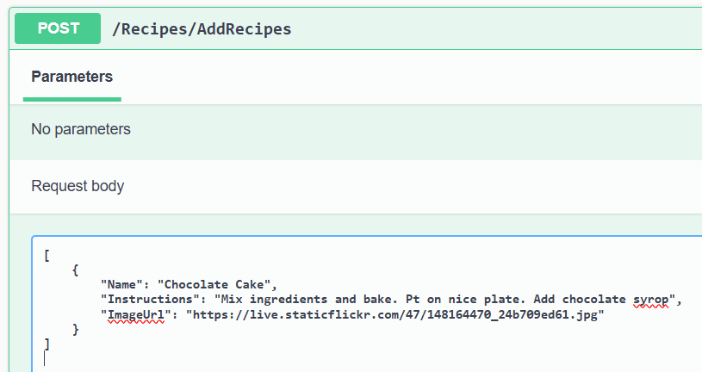
Your Hacker’s Goal – Server-Side Edition
Detect an alternative method to upload recipes

Slide 95
Your Hacker’s Goal – Server-Side Edition
Server-Side Request Forgery
How can you use the URL interface and get the secret anyway?

Slide 96
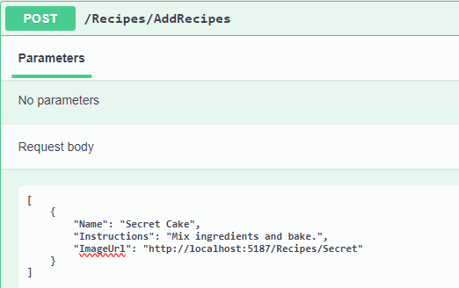
Your Hacker’s Goal – Server-Side Edition
Using swagger to add recipes
Send the following payload:

Slide 97
Your Hacker’s Goal – Server-Side Edition
Where is the fake image with the secret?
Can you guess?

Slide 98
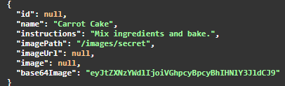
Your Hacker’s Goal – Server-Side Edition
Where is the fake image with the secret?
Can you guess?
Try to check the images in swagger

Slide 99
SSRF Protection
Fix the code!

Slide 100
SSRF Protection
Where should be the fix?
What should you do?

Slide 101
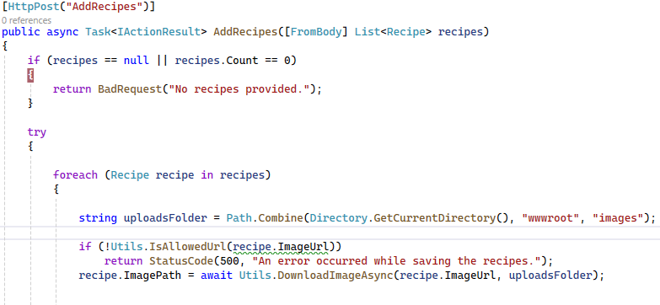
SSRF Protection

Slide 102
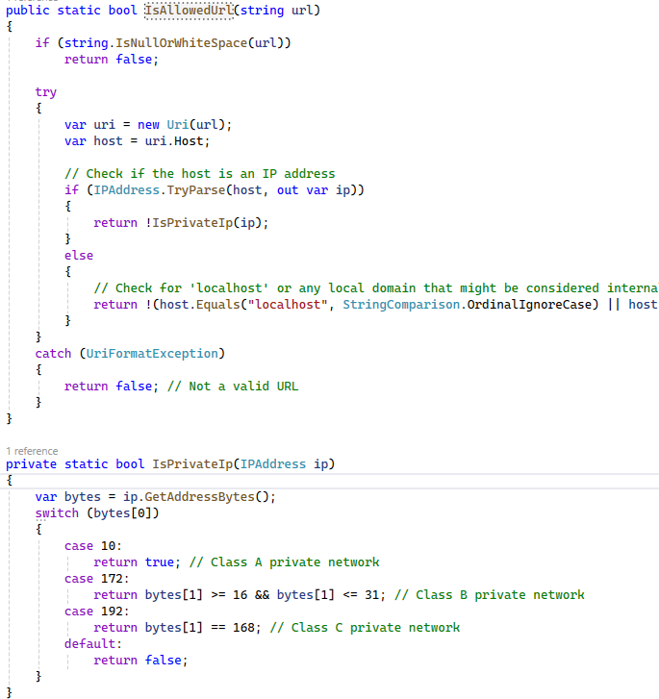
SSRF Protection

Slide 103
SSRF Protection
What else should be done in addrecipes?

Slide 104
Part 5: Attacking and Defending .net core 8 web api – SQLi

Slide 105
Your Hacker’s Goal – Server-Side Edition
SQL Injection vulnerability
Allows an attacker to run SQL commands.
Happens because there is no separation between data and code.
(Trust boundaries issues)

Slide 106
Your Hacker’s Goal – Server-Side Edition
SQL Injection vulnerability
Exploit the addrecipe method to get data from Users table

Slide 107
Your Hacker’s Goal – Server-Side Edition
SQL Injection vulnerability
Exploit the addrecipe method to get data from Users table
The full SQL command:
INSERT INTO Recipes (Name, Instructions, ImagePath) VALUES ('test', 'test','test');insert into Recipes(Name, Instructions, ImagePath) select username,username,password from Users; --
The payload:
','test');insert into Recipes(Name, Instructions, ImagePath) select username,username,password from Users; --

Slide 108
Your Hacker’s Goal – Server-Side Edition
SQL Injection vulnerability
Any idea how to read the username and password we’ve got from users table?

Slide 109
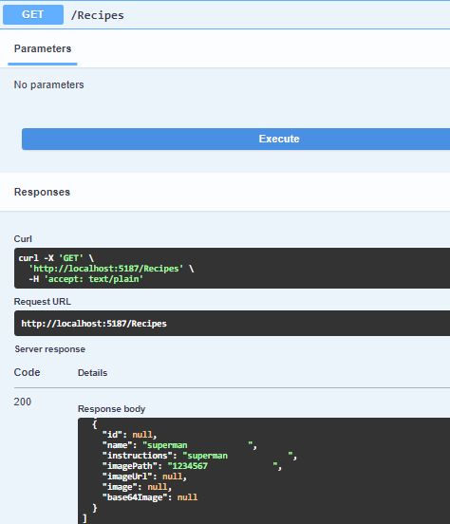
Your Hacker’s Goal – Server-Side Edition
SQL Injection vulnerability
Any idea how to read the username and password we’ve got from users table?

Slide 110
Dealing with SQL securely
How? Any Ideas?

Slide 111
Dealing with SQL securely
Use Parametrized Queries

Slide 112
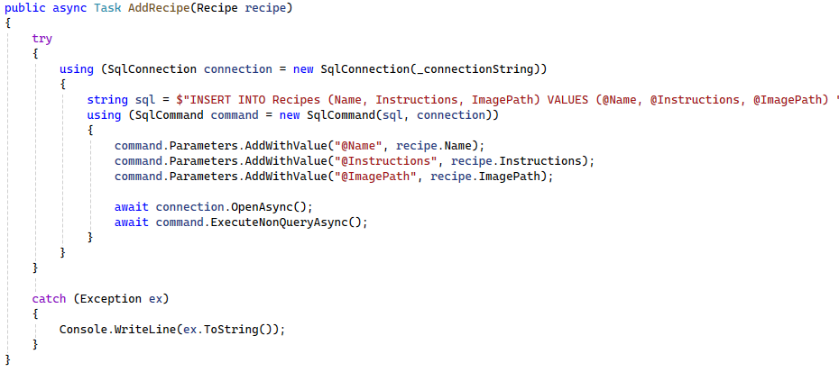
Dealing with SQL securely
Use Parametrized Queries

Slide 113
PREVENT - SFS Principles
Priority, Privacy, Permissions
Reporting & logging
Easy to use securely
Verify
Errors & exceptions
Neat code
Trust Boundaries

Slide 114
Dealing with SQL securely
Use Interpolated (Formatted) Strings

Slide 115
Summary

Slide 116
PREVENT - SFS Principles
Priority, Privacy, Permissions (CSRF, SSRF)
Reporting & logging
Easy to use securely (Angular, SQL)
Verify (3rd party)
Errors & exceptions
Neat code
Trust Boundaries(XSS, File Upload)

